Slide 1
Reflection and JUnit
Testing structures in student code
Cody Henrichsen

Slide 2
JUnit Intro
Unit Testing is designed to make sure the code does what it says it should do
Each class gets its own test class
Each method should get a test that validates it operates correctly
Test public methods easily
Test private methods by checking the state modifications occur
Test console output in discrete chunks (next video)

Slide 3
Reflection Intro
Reflection is the Java library that allows Java to look at itself programmatically
You are able to see what makes up the class, both private and public information
You can even inspect the parameters and their associated data
The only thing you aren’t able to see are the imports

Slide 4
Combine to validate student code
By combining the power of JUnit and Reflection you can write test code to ensure that students are building the projects correctly and then have the students run the tests themselves as they write the project so they can make sure the green bar of joy is displayed!
Using these tests for all code assignments can help ensure students put code together properly each time
Add additional tests as needed for complexity and correctness
Student ownership of completion

Slide 5
JUnit version note
All JUnit code is based on JUnit 5. If you are still using version 4 you will need to adjust the imports accordingly and reverse all the assertWhatever method parameters since previous versions had message first, then the tested values

Slide 6
Basic Testing Setup
I like keeping all my tests in a separate package from the rest of the code.
My projects use the following package naming convention
  project.role
    art.view
    demo.controller
Thus all the tests are in the prefix.tests package

Slide 7
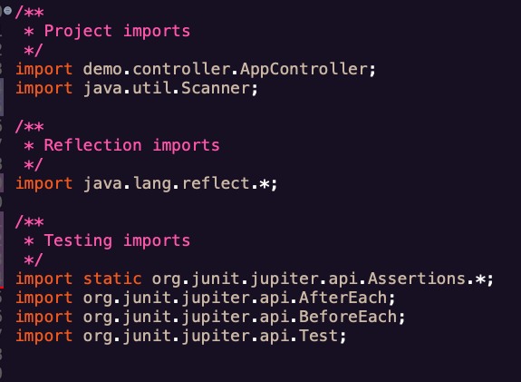
Test Structure: Imports
Tested class and any related files
  Package based
  External needs for component tests
    Scanner
    Swing
Reflection library
  Constructor
  Field
  Method
JUnit library
  Static import for all the Assertions
  Imports for the Annotation markers

Slide 8
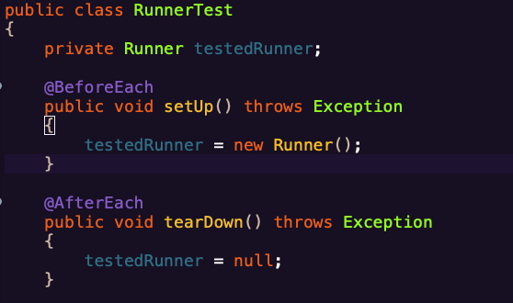
Test Structure: Basic
Data member
  An instance of the class under the test
Required tests
  setUp()/tearDown()
Testing stops at the first failure

Slide 9
Test Structure: main
Check that the main method is correct
  Modifiers
  Return type
  Name
  Parameter
  Runner should only have the main method
Remember that the test/fix process should be iterative

Slide 10
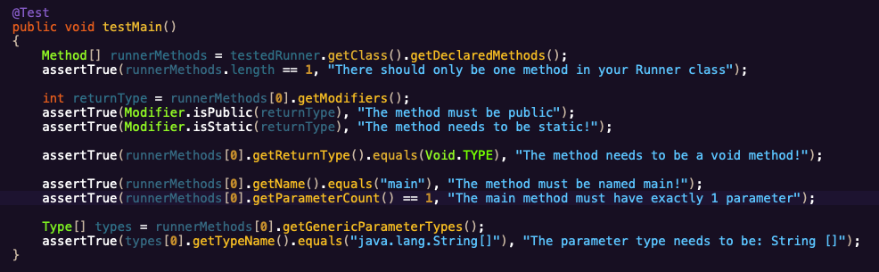
Example: testMain

Slide 11
General Structure Testing
You can check that all the methods of the class are present.
This is great to check that students are building their framework code appropriately
You can check that they are specifying the correct visibility and types for the methods
For required methods: make a counter variable, iterate over the methods, check each name and increment appropriately
For data members make a counter variable, iterate and check count and types

Slide 12
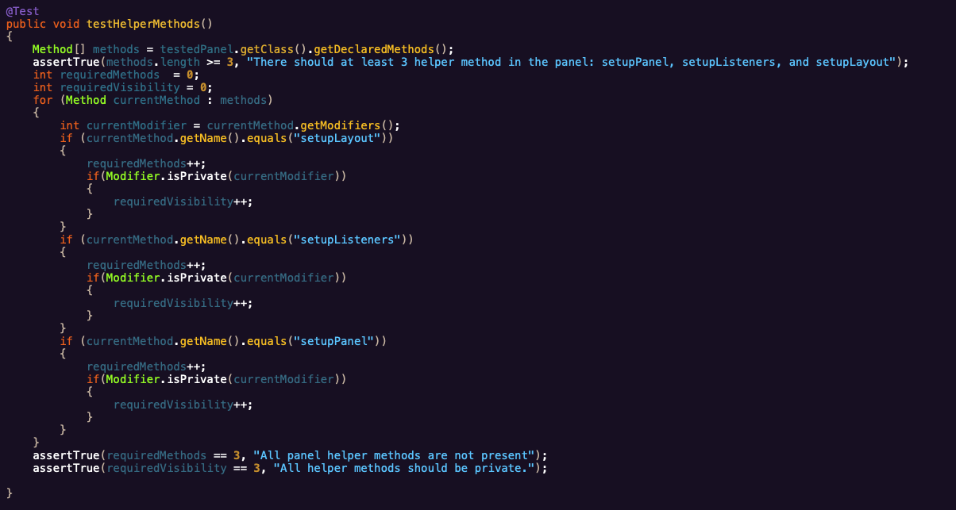
Example: required methods

Slide 13
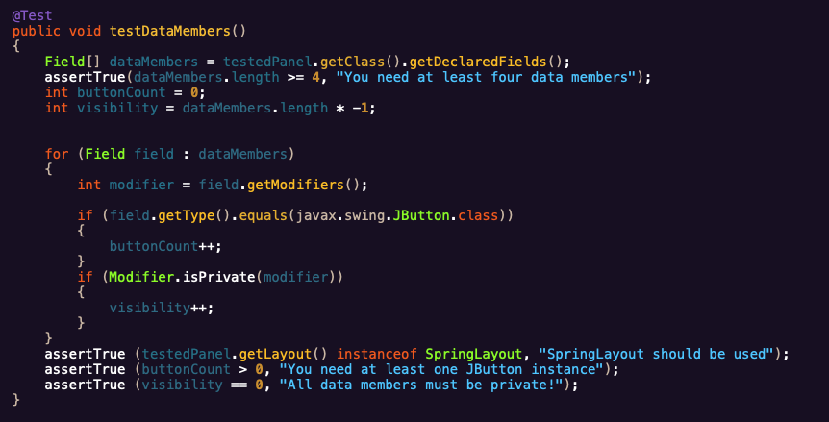
Example: data members

Slide 14
Student side
You bundle tests in a ZIP file and distribute to students (LMS/web)
Students import tests to project
Students run tests
Students use tests to fix code if needed
Turn in or checkoff showing they passed framework tests

Slide 15
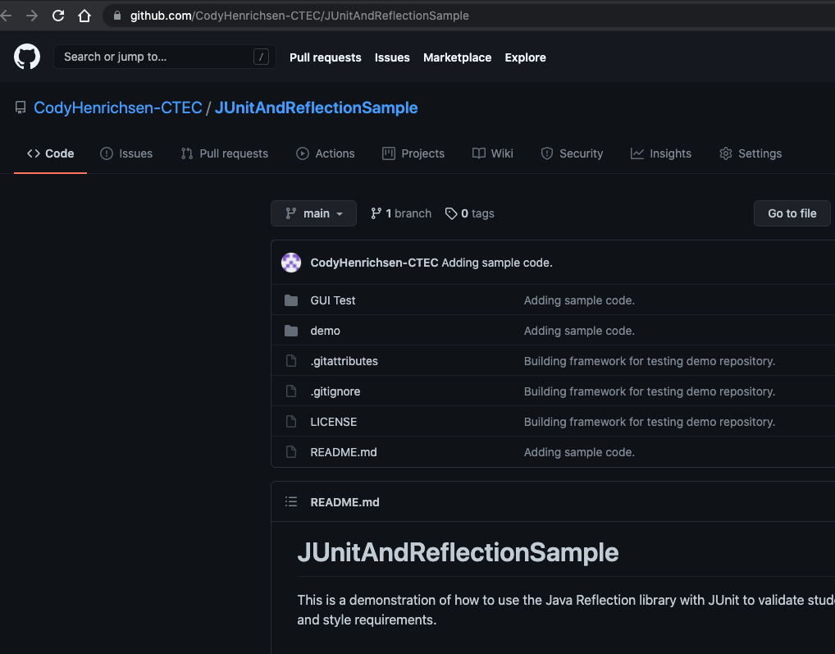
Repository
Sample code is available at the link below including this presentation, and student code.
  https://github.com/CodyHenrichsen-CTEC/JUnitAndReflectionSample

